Slide 1

CSE 6748 Final Presentation
Fulton Team 7
Thu T Le - Winnie Taiwo - Luke K Santoso

Slide 2
Project Goal
Design a user-friendly dashboard for school staff in Fulton County to enhance student achievement metrics for grades 3-5.
Visualize Student Performance: Display Georgia Milestones and CCRPI scores for better academic tracking.​
Monitor Attendance & Graduation Rates: Identify trends and areas that need intervention.​
Support Data-Driven Decisions: Provide actionable insights to help educators and administrators improve student outcomes.​
Ensure Easy Access & Collaboration: Integrate with Tableau

Slide 3


Why Important?
Early Identification of Learning Gaps: Dashboards help identify struggles in key areas like math and reading, allowing for timely intervention.
Critical Transition Years: Grades 3-5 are when students shift from learning to read to reading to learn
Personalized Learning Needs: Teachers can tailor instruction to student’s strengths and weaknesses, ensuring all students progress.
Smooth transition to Middle School: Prepare students for challenges in middle school.

Slide 4

Method
Framework
PLANNING AND PREPARATION
1
Define Objectives and Metrics, then Gather and Inventory Data Sources, Outline Data Needs and Requirement
DATA COLLECTION AND CLEANING IN PYTHON
2
Use Python to Extract, Clean the Data, Merge Dataset and Select Important Features using Correlation and Recursive Feature Selection
BUILD THE DASHBOARD IN TABLEAU
3
Import data into Tableau, Create Visualizations, and Add Recommendations
DEPLOY, SHARE AND MAINTAIN THE DASHBOARD
4
Review/Refine Dashboard and Publish the Dashboard to Tableau Public.

Slide 5


Data Sources: Extensive Cleaning and Merging
Data Processing & Cleaning
DATA
CLEANING
Georgia Milestone Datasets
Georgia Milestone is a standardized summative assessment administered at the end of the year to evaluate student performance against state standards in multiple subjects. This dataset was provided by Fulton County Schools.
✔ Dataset Size: Contains multiple assessment-related fields and Include 381384 data. From Grade 3- Grade 5, we have 134015 data. ✔ Performance Metrics: Includes Scale Scores, Achievement Levels, and Grade Conversion Scores. ✔ Student Growth Tracking: Captures Student Growth Percentile and Growth Level. ✔ Reading & Writing Analysis: Lexile scores, extended writing responses, and reading indicators. ✔ Testing Information: Includes Test Grade, Testing Date, and Retest Flags for performance tracking.
1
Review Variables definitions
2
Handle missing values
3
Data Merging by Python
4
Feature Selection

Slide 6
Data Sources: Extensive Cleaning and Merging (Cont.)
Data Processing & Cleaning
DATA
CLEANING
Enrollment Data and School Information Data
Enrollment Data includes the enrollment information such as Student ID, School ID, Grade level, Hardship or not
School data includes information about the School such as School ID, location, etc. .
1
Review Variables definitions
2
Handle missing values
Attendance and Discipline Data
3
Attendance Data includes the students’ attendance records.
Graduation data includes the students’ credit still needed for graduation.
Data Merging by Python
4
Feature Selection
CCRPI Score
This data source includes Scores such as Content Mastery, Progress, Closing Gap, Readiness for Elementary schools from 2022-2024.
Manually match the School Name with the corresponding School ID in the dataset and add the SchoolYearID to prepare for the merge.
Obtained from website https://ccrpi.gadoe.org/Reports/Views/Shared/_Layout.html

Slide 7
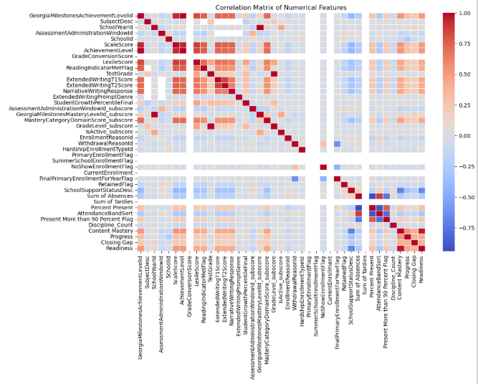
Correlation Matrix
Feature Selection
After merging the data, we have 1458814 rows and 122 columns.
.
Correlation Matrix helps us understand the degree and direction of association between pairs of variables. With over 40 columns, we examined correlations exceeding 0.1.
CONTINUED ON NEXT SLIDE

Slide 8
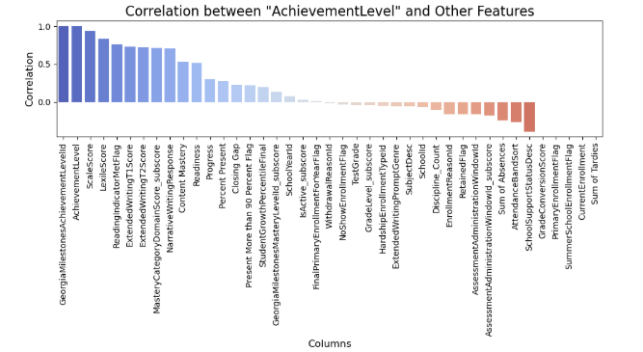
Correlation Matrix
Feature Selection
.
Important features include Master Category Domain Score, School Support, Discipline Count, Attendance, Enrollment Reasons, Percent Present.
CONTINUED ON NEXT SLIDE

Slide 9
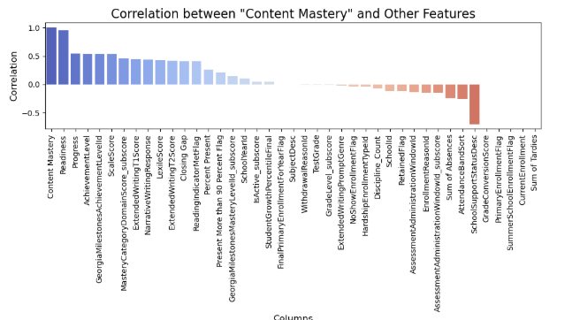
Correlation Matrix
Feature Selection
.
Important features include Scale Score, Subject, School Support, Discipline Count, Attendance, Enrollment Reasons.
CONTINUED ON NEXT SLIDE

Slide 10
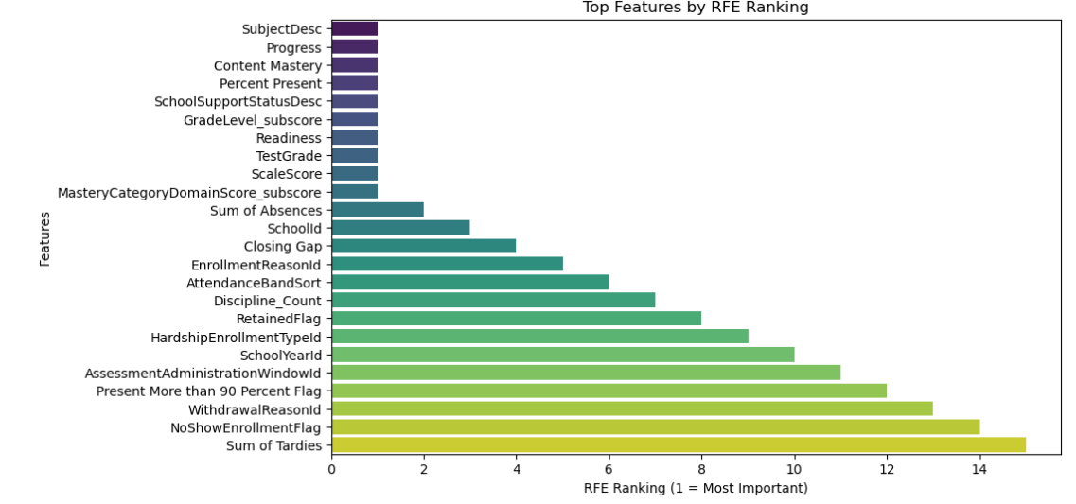
Most Important Features using RFE
Feature Selection
Recursive Feature Elimination (RFE) is a feature selection technique that helps identify the most important features in a dataset by recursively fitting the model and eliminating the least important features.
.
Important features include Scale Score, Subject, Percent Present, School Support, Master Category Domain Score, Discipline Count, Attendance, Enrollment Reasons.

Slide 11
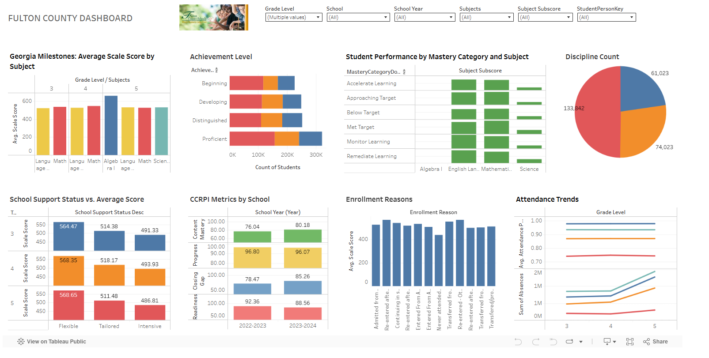
Build Dashboard in Tableau
Next Step
By selecting the most important features from RFE, we build a story in Tableau to facilitate further analysis. Tableau enhances data visualization and helps uncover valuable insights.
Link to Tableau Public: Fulton County Dashboard | Tableau Public

Slide 12
Thank you!

